Slide 1
FlexPoints Using RL to Create a Betting Product
N. Ahmed, S. Siegel, and J. Fuest

Slide 2
Background
Sports Betting
FlexPoints
Data

Slide 3


Sports-betting is one of the hottest new markets in the country, and we can expand on it with RL
Environ.
(Sports)
Agent
(Bettor)
The sports-betting market has undergone explosive growth since legalization in 2018
Reinforcement learning allows for complex derivative products to be accurately priced
Source: Gabelli Securities as cited by Variety, March 3, 2021

Slide 4
Traditional sports-betting calculates a pay-out at the end the game
J / S
Line =
Payout Philosophy
Background on betting

Slide 5
With FlexPoints, players can cash-out at any time, providing more opportunities to win!
J / S

Slide 6
We utilize open-source NBA data and sports analytics expertise to engineer our product
S
Quarter | Player | Points | Avg. Points | Avg. Team Points | Opp. Avg. Points | …
3 | L. James | 21 | 27.2 | 103.3 | 107.4 | …
4 | L. James | 29 | 27.2 | 103.3 | 107.4 | …
0 | S. Curry | 0 | 25.8 | 108.1 | 103.2 | …
1 | S. Curry | 7 | 25.8 | 108.1 | 103.2 | …
2 | S. Curry | 15 | 25.8 | 108.1 | 103.2 | …
3 | S. Curry | 18 | 25.8 | 108.1 | 103.2 | …
4 | S. Curry | 26 | 25.8 | 108.1 | 103.2 | …
Source: Basketball Reference
Samples: 5.336 player games
13 numeric features

Slide 7
Pricing Algorithms
Least Squares Policy Iteration (LSPI)
Deep Q-Learning (DQL)

Slide 8
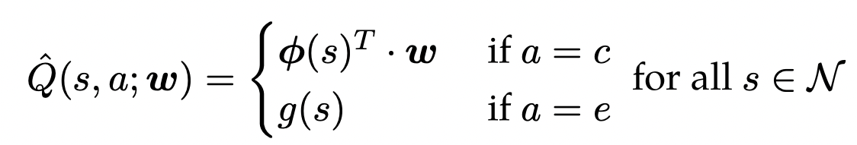
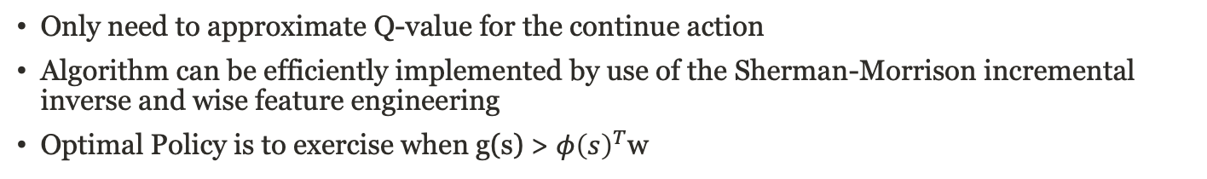
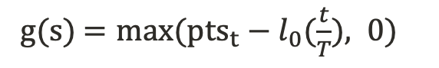

LSPI is a standard approach for pricing via a linear relationship with our engineered features
$$φ{\left(s\right)}^{T}=[{t, pts}_{t}, l_{0}, avg team points, …]$$
g(s) $=max⁡(pts_{t}−l_{0}(\frac{t}{T}), 0)$
Only need to approximate Q-value for the continue action
Algorithm can be efficiently implemented by use of the Sherman-Morrison incremental inverse and wise feature engineering
Optimal Policy is to exercise when g(s) > $φ{\left(s\right)}^{T}$w
Source: RL-Book

Slide 9
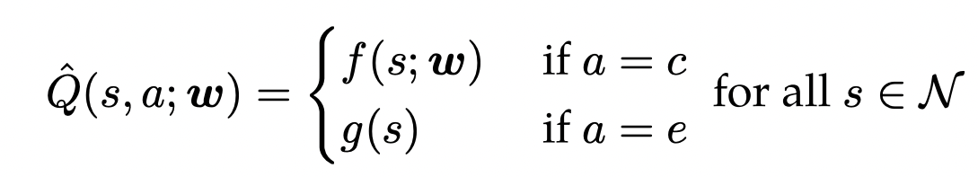

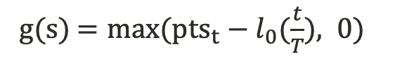
Deep Q-Learning allows for even greater modelling flexibility, but convergence can be a challenge
g(s) $=max⁡(pts_{t}−l_{0}(\frac{t}{T}), 0)$
DQL utilizes the semi-gradient for model weight updates
Standardization of features, learning rate decay, and random sampling of atomic experiences aids model convergence
Philosophy: price against sophisticated bettors to avoid being exploited, so sell this option at Q-value function plus a margin
Source: RL-Book

Slide 10
Pricing Examples
In-Sample Example
Out-of-Sample Example (Audience Participation!)

Slide 11
Stephen Curry vs Nuggets Jan 15th 2019
S
Exercise Value
Q-Value (LSPI)
Optimal Action

Slide 12
Example from Last Weekend
Audience Participation Example
D’Angelo Russell vs Knicks
DLO’s rolling avg.: 17.8
Price of option: $0.09
Optimal Policy:
Q1: Stop
Q2: Stop
Q3: Stop
→ Bettor wins 8.46$

Slide 13
Thank You

Slide 14
Possible Improvements
Buy-in mid-game using Q-value plus a mark-up
Extension to more granular time intervals
Cash-out at any stoppage in play
Offer cash-out below Q-value when exercise value is zero

